Slide 1
Vulnerabilities Assessment Presentation
By Dean Baberowski

Slide 2


Presentation Overview
This presentation will cover:
Network Overview
Red Team Offensive
Blue Team Defence
Network Analysis
Notes:
The Overview Slide, Explain here what is covered in this presentation: it should not go longer than 5 minutes, so keep it short and concise.

Slide 3
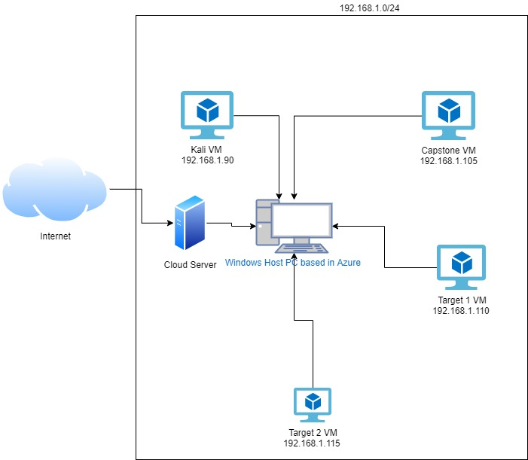
Network Topology
NETWORK
Network
Address Range: 192.168.1.0/24
Netmask:255.255.255.0
Gateway:192.168.1.0
Machines
IPv4:192.168.1.105
OS: Windows
Hostname: Capstone VM
IPv4: 192.168.100
OS: Linux
Hostname: ELK VM
IPv4: 192.168.1.90
OS: Kali Linux
Hostname: Kali
IPv4: 192.168.1.110
OS: WIndows 6.1
Hostname: Target 1 VM
IPv4: 192.168.1.115
OS: Windows 6.1
Hostname: Target 2 VM
[Insert Here]
Notes:
The network topology as shown here in this diagram indicates that the Azure host machines hosts all the nested virtual machines that are used for this project. The ELK VM is used for monitoring alerts on the system through Kibana.

Slide 4

Red Team Offensive & Critical Vulnerabilities

Slide 5
Critical Vulnerabilities : Target 1
Vulnerability | Description | Impact
SSH Vulnerability CVE 1999-0398 | Gaining SSH access to a server | Anyone can login with the user’s account credentials
Wordpress Vulnerability CVE-2009-3891 | Wordpress web page has a vulnerability where anyone can see the files of the system | Anyone can access Wordpress configuration files
SQL Injection CWE 422 | A manual SQL injection can be done the web server | Defacing the site and potentially stealing information
RPC Bind #100000 CVE 2017-8779 | A vulnerability in a Microsoft Server system | Anyone can access the server
Weak Passwords CWE-522 | A password that is not complex and based on a name | Anyone can guess the password with little effort and gain access to the web server
Samba smbd vulnerability CVE-2019-3824 | Files can be uploaded to a server using the smbd protocol | Once in the server an attacker can upload malicious files
The Assessment uncovered the following critical vulnerabilities in Target 1.
Notes:
To avoid over complicating things briefly touch on these vulnerabilities

Slide 6
Critical Vulnerabilities: Target 2
Vulnerability | Description | Impact
SSH vulnerability - CVE-1999-0398 | SSH Vulnerability | Gaining SSH access to a server
Wordpress Vulnerability CVE-2009-3891 | Wordpress web page has a vulnerability where anyone can see the files of the system | Anyone can access Wordpress configuration files
SQL Injection CWE 422 | A manual SQL injection can be done the web server | Defacing the site and potentially stealing information
Weak Password CWE-522 | A password that is not complex and based on a name | Anyone can guess the password with little effort and gain access to the web server
SSH vulnerability - CVE-1999-0398 | SSH Vulnerability | Gaining SSH access to a server
Wordpress Vulnerability CVE-2009-3891 | Wordpress web page has a vulnerability where anyone can see the files of the system | Anyone can access Wordpress configuration files
The assessment uncovered the following critical vulnerabilities in Target 2.

Slide 7

Exploits

Slide 8
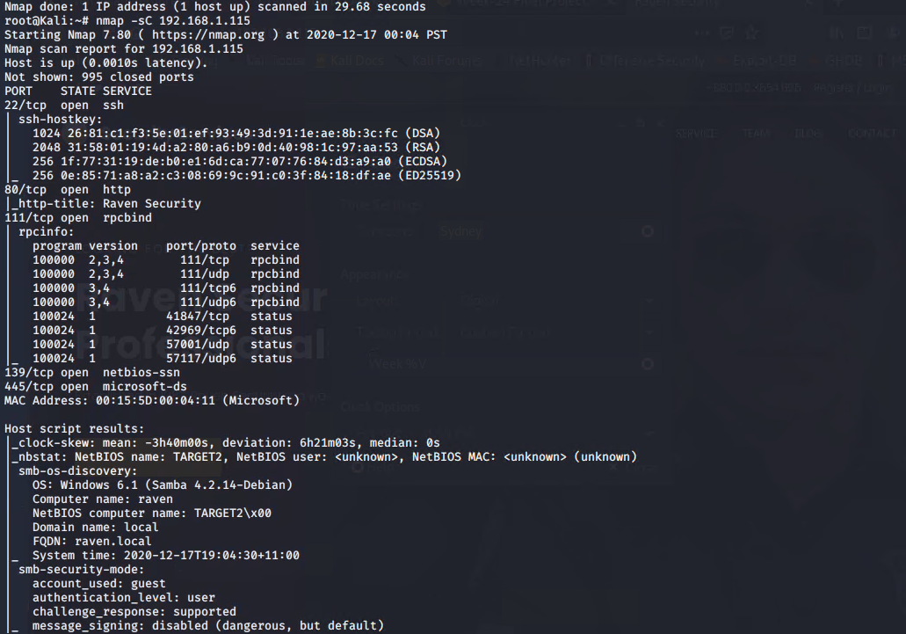
Exploitation: Exploring open ports
Using nmap Stealth scan
The nmap scan showed potential ports to exploit

Slide 9
Exploitation: Weak passwords
The vulnerability was exploited using the name of the user micheal and the ip address of the target machine using ssh
The exploit gained me access to the system
command: ssh michael@192.168.1.110 password: michael

Slide 10
Avoiding Detection

Slide 11
Stealth Exploitation of HTTP Requests
Monitoring Overview
The high amount of HTTP requests would detect this alert
The HTTP.response metrics is measured when is it above the threshold of 3500
Mitigating Detection
You can execute the exploit without being detected by editing the HTTP request line on a website

Slide 12
Stealth Exploitation of High CPU Usage
Monitoring Overview
Which alerts detect this exploit?
High CPU Usage
Which metrics do they measure?
Cpu.usage
Which thresholds do they fire at?
Above 0.5
Mitigating Detection
How can you execute the same exploit without triggering the alert?
You can use the same exploit by changing the command and monitoring it using task manager

Slide 13
Maintaining Access

Slide 14
Backdooring the Target
Backdoor Overview
Installed a Reverse shell backdoor into the target system
Used metaspoit to drop the backdoor
use exploit
Connected to it by a custom shell exploit script
./exploit.sh

Slide 15

Blue Team Defense & Critical Vulnerabilities

Slide 16
Critical Vulnerabilities: Target 1
Vulnerability | Description | Impact
SSH Vulnerability | The SSH port is open | An attacker could access the system
Wordpress database | Modification to the file system is possible | It is a minimal impact to the system
SQL Database | Using Hibernate to execute dynamic SQL statements | An attacker can access the SQL database
HTTP Injection | The software does not neutralize or incorrectly neutralizes user-controllable input before it is placed in output that is used as a web page that is served to other users | An attacker can modify input
The assessment uncovered the following critical vulnerabilities in Target 1

Slide 17
Critical Vulnerabilities: Target 2
Vulnerability | Description | Impact
SSH Vulnerability | The SSH port is open | An attacker could access the system
HTTP Injection | The software does not neutralize or incorrectly neutralizes user-controllable input before it is placed in output that is used as a web page that is served to other users | An attacker can modify input
SQL Database | Using Hibernate to execute dynamic SQL statements | An attacker can access the SQL database
The assessment uncovered the following critical vulnerabilities in Target 2.

Slide 18
Hardening/ Mitigation
Made for Virtual Demo Day Jan 2021 | Dean Baberowski

Slide 19

Hardening Against wordpress vulnerability on Target 1
To patch Target 1 against wordpress vulnerability:
Use the patch: wget http://wordpress.org/latest.zip to update WordPress
It works because WordPress releases weekly updates and so do the third-party plugins and it is important to update wordpress and the plugins regularly
Image from Webroot.com
Made for Virtual Demo Day Jan 2021 | Dean Baberowski

Slide 20

Hardening Against SSH on Target 1
To patch Target 1 against SSH Vulnerability:
Fail-ban blocks access to ssh ports
use apt install fail2ban
Made for Virtual Demo Day Jan 2021 | Dean Baberowski

Slide 21
Hardening Against SSH on Target 2
To patch Target 2 against SSH:
It targets a particular port
install ufw to block ip requests that could target SSH port
Once install check that its enabled
Made for Virtual Demo Day Jan 2021 | Dean Baberowski

Slide 22

Hardening Against SQL Injection on Target 2
To patch Target 2 against SQL Injection:
Use Input validation techniques to verify input of a users, this can be set up the SQL database
The technique works because it verifies the users input before it is accepted on the website
Image from sitepoint.com
Made for Virtual Demo Day Jan 2021 | Dean Baberowski
Notes:
Talk about input sanitisation on websites and briefly touch on why it is important

Slide 23

Network Analysis
& Traffic Profile
Made for Virtual Demo Day Jan 2021 | Dean Baberowski

Slide 24
Traffic Profile
Feature | Value | Description
Top Talkers (IP Addresses) | 192.168.1.110 | Machines that sent the most traffic.
Most Common Protocols | TCP and UDP | Three most common protocols on the network.
# of Unique IP Addresses | 5 | Count of observed IP addresses.
Subnets | /24 | Observed subnet ranges.
# of Malware Species | 3 | Number of malware binaries identified in traffic.
The analysis identified the following characteristics of the traffic on the network:
Made for Virtual Demo Day Jan 2021 | Dean Baberowski

Slide 25

Questions

Slide 26
The End

